Slide 1

Minor Project on
Nepali Fake News Detection
Submitted by
Abhishek Sah [21075393]
Abhishek Shrestha [21075394]
Dibas Timalsena [21075410]
Nirmal Khatri [21075419]
Submitted to
Department of Computer and IT Engineering
Everest Engineering College
Sanepa-2, Lalitpur
Affiliated to Pokhara University
Date:12/27/2024

Slide 2
Contents
Introduction
Problem Statement
Objective
Literature Review
Methodology
Evaluation/Testing
Result and Discussion
Conclusion
References

Slide 3
Introduction/Background
Fake news includes fabricated stories, propaganda, and misleading headlines.
Social media amplifies misleading content, affecting public trust in media.
Misinformation spreads rapidly due to high user engagement on social platforms.
Fake news can change people's opinions, cause fights, and weaken democracy.

Slide 4
Problem Statement
With the current usage of social media platforms, consumers are creating and sharing more information than ever before, some of which are misleading with no relevance to reality.

Slide 5
Objective
To address the spread of fake news by applying machine learning algorithms with (NLP).

Slide 6
Literature Review
Soniya C. J. & Shrihari M. R. (2020). Fake news detection using AI, NLP, and ML techniques.
Objectives of Reviewed Project:
To classify online news articles as either fake or real using AI, NLP, and ML techniques.
Final Findings of Reviewed Project:
Successfully performed binary classification on various online news articles, demonstrating the potential of AI-driven solutions in fake news detection.

Slide 7
Birunda S. S., & Devi R. K. (2021). A Novel Score-Based Multi-Source Fake News Detection using Gradient Boosting Algorithm
Objectives of Reviewed Project:
To develop a score-based multi-source fake news detection system using the Gradient Boosting Algorithm.
Final Findings of Reviewed Project:
The system improved accuracy by combining information from multiple sources, making it more reliable in detecting fake news.

Slide 8
Sathyabama (2021). Fake news detection using machine learning techniques.
Objectives of Reviewed Project:
To develop a machine learning model that can effectively detect fake news.
Final Findings of Reviewed Project:
The project successfully utilized ML algorithms to detect fake news but provided limited details on model scalability and real-world application.

Slide 9
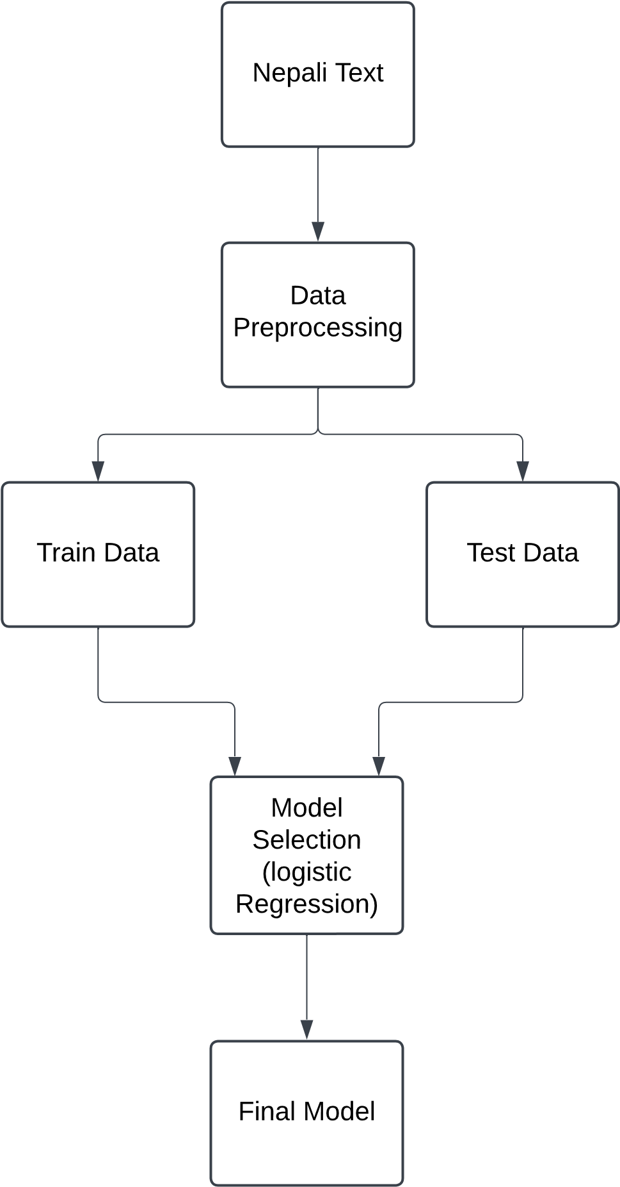
Methodology

Slide 10
Machine Learning Algorithm
Logistic regression
Mostly used in binary classification. Very effective in spam detection and fake news.
The core of Logistic Regression lies in the logistic function (sigmoid), which maps the raw prediction scores to a probability between 0 and 1.

Slide 11
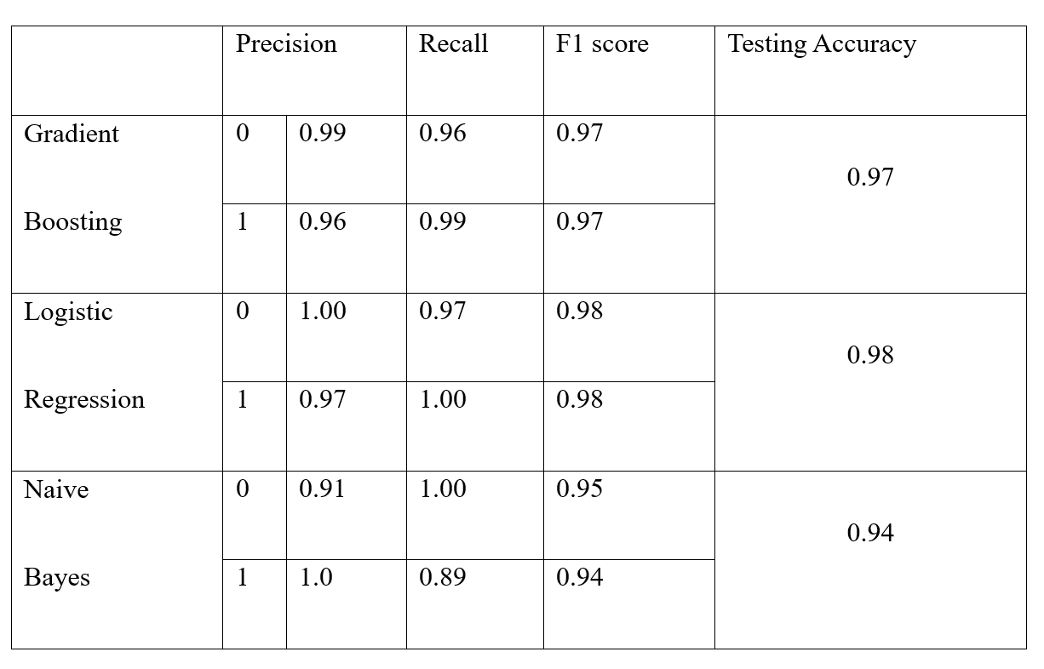
Reason for Choosing Logistic regression
In our performance metrics, the accuracy of Logistic Regression is higher than both Naïve Bayes and Gradient Boosting, making it the preferred choice for Nepali fake news detection.

Slide 12
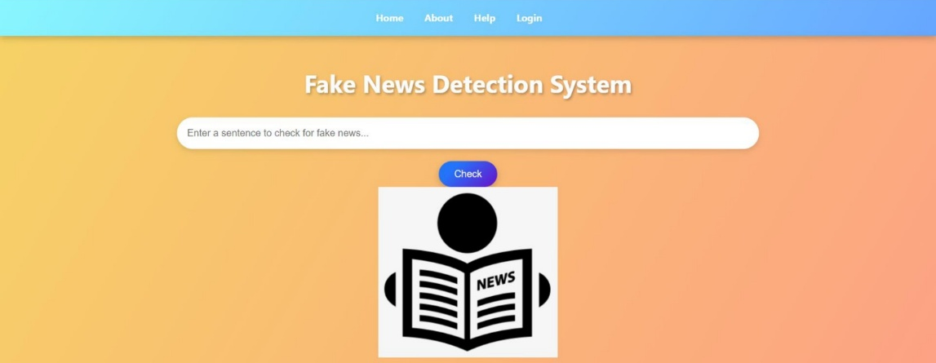
Expected Outcome

Slide 13
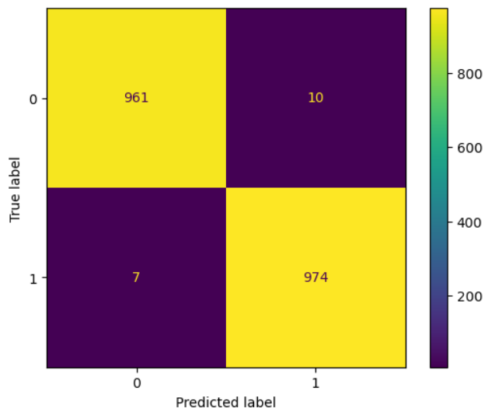
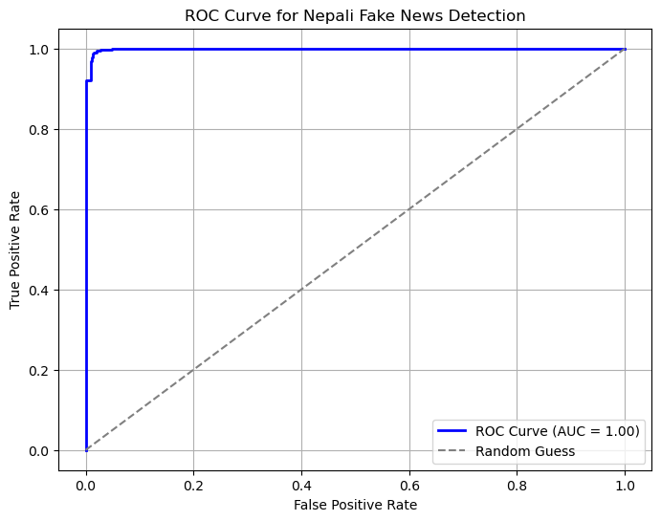
Confusion matrix and ROC curve of our Project

Slide 14
Conclusion
Despite achieving high performance with precision, recall, and F1-scores near 99%, the model faces challenges in accurately identifying real news. These limitations stem from linguistic complexities in the Devanagari script, such as variations in word usage, contextual meanings, and the absence of extensive labeled datasets.

Slide 15
Future Extension:
Automate data collection and preprocessing to keep the dataset updated continuously.
Enhance text preprocessing by exploring advanced Devanagari script tokenization, stemming, and lemmatization techniques.
Train the model on a larger, diverse dataset to improve accuracy and generalization.
Train the model on a larger, diverse dataset to improve accuracy and generalization.

Slide 16
References
[1] Soniya C J And Shrihari M R on fake news detection.
https://sjcit.ac.in/wp-content/uploads/2022/11/1SJ18CS098-soniya-cj-1.pdf
[2] Birunda S. S., & Devi R. K. (2021). A Novel Score-Based Multi-Source Fake News Detection using Gradient Boosting Algorithm.
https://sist.sathyabama.ac.in/sist_naac/documents/1.3.4/b.e-cse-batchno-214.pdf
[3] Birunda S. S., & Devi R. K. (2021). A Novel Score-Based Multi-Source Fake News Detection using Gradient Boosting Algorithm.
https://www.researchgate.net/publication/350936038_A_Novel_Score-Based_Multi-Source_Fake_News_Detection_using_Gradient_Boosting_Algorithm
[4] https://youtu.be/f7ckMaEJvh4?si=GLAYHs4qyomC67Db
[5] https://www.scribd.com/document/605810234/Fake-News-Detection-report

Slide 17
Thank You !!!

